Slide 1
LSC eligibility across the United States

Slide 2
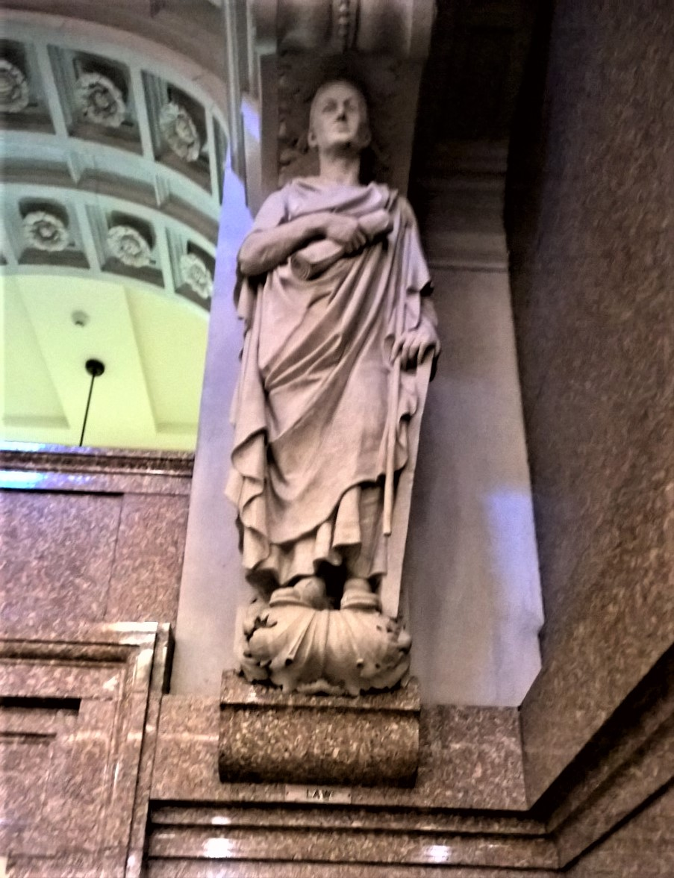

Why This Project?
The Access to Justice Crisis
Stakeholders
States
Attorneys
Members of the Public
The Judicial System
Current options
Searching on own
Doing nothing
Notes:
Domingo Mora - Law
Author’s Own Photo Library
System Index Search
https://upload.wikimedia.org/wikipedia/commons/thumb/f/f1/System-index-search.svg/600px-System-index-search.svg.png

Slide 3


The Indispensable Ingredients
Stakeholders
States
Attorneys
Members of the Public
The Judicial System
Partner
Professor Colarusso
Renowned Legal Innovator
Directing from user generated information inputted into spot to determine eligibility for LSC services in area
Notes:
Typing
https://upload.wikimedia.org/wikipedia/commons/4/4e/Computer_keyboard.png
Legal Services Corporation
https://upload.wikimedia.org/wikipedia/en/2/2a/Legalservicescorp.jpg

Slide 4
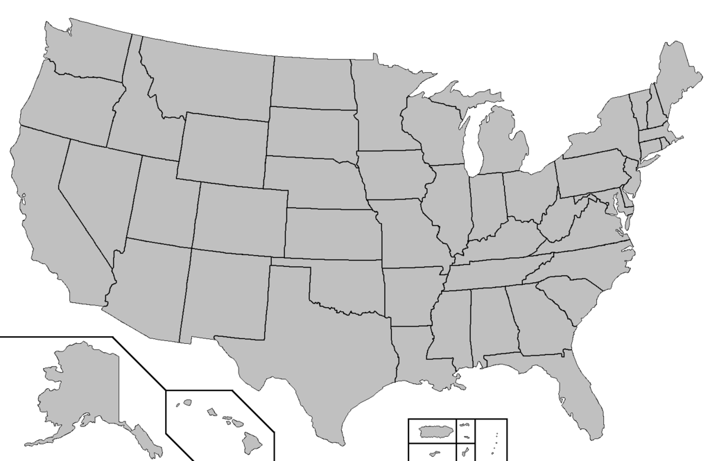
Spot
Notes:
Map of the United States
https://upload.wikimedia.org/wikipedia/commons/thumb/9/9d/Blank_map_of_the_United_States.PNG/1024px-Blank_map_of_the_United_States.PNG

Slide 5
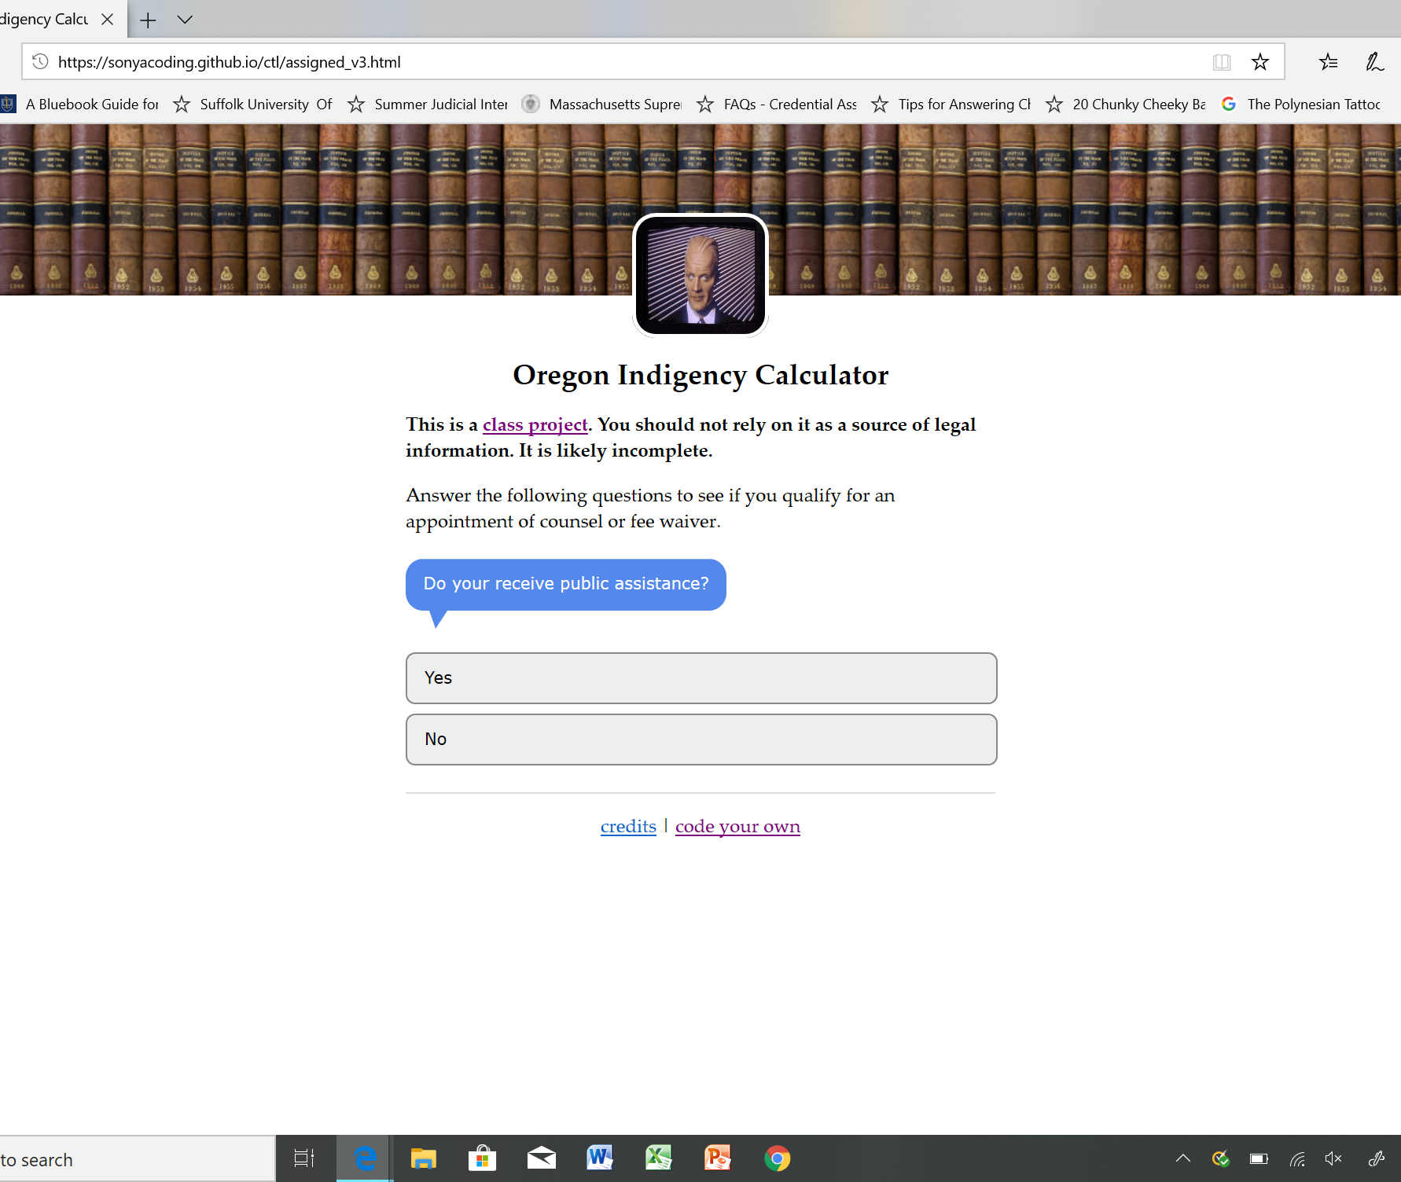
The Focal Point
Questionnaire for each jurisdiction
Starts by asking how to proceed
Similar to Indigency Calculator
Notes:
https://sonyacoding.github.io/ctl/assigned_v3.html

Slide 6
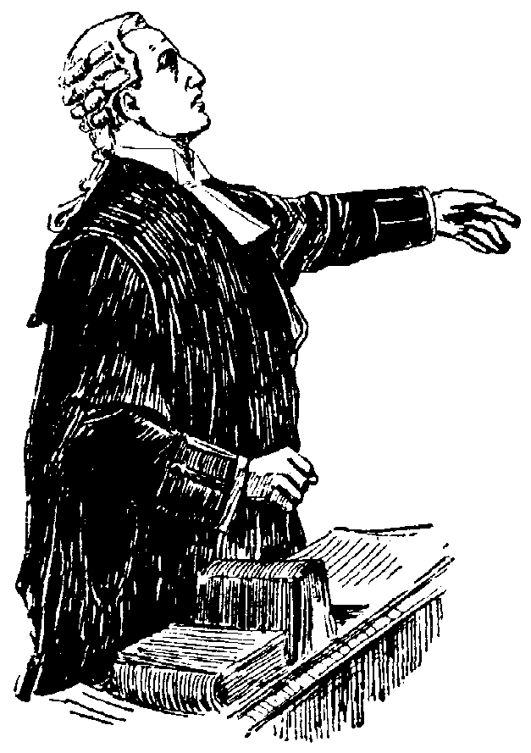
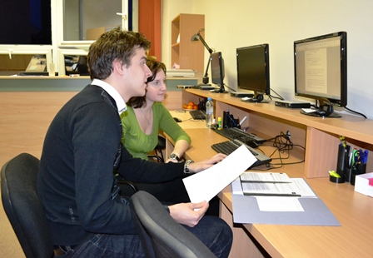
Direction
After asking how to proceed directs to one of two places
Allows individual to search for attorneys in area
Otherwise, opt to go through eligibility questions
If eligible directs to LSC/Legal Aid organization for designated area or jurisdiction
Notes:
Barrister
https://upload.wikimedia.org/wikipedia/commons/5/5f/Advokat%2C_Engelsk_advokatdräkt%2C_Nordisk_familjebok.png
Legal Clinic Office, Palacky University
https://upload.wikimedia.org/wikipedia/commons/c/cc/Legal_clinic_office%2C_Palacky_University.jpg

Slide 7

Questions?
Notes:
https://upload.wikimedia.org/wikipedia/commons/thumb/5/54/Question_Noun_project_2185.svg/600px-Question_Noun_project_2185.svg.png

